Slide 1
System Level Programming
Software College of SCU
Tiny Linker Lab Instruction

Slide 2
Lab: Tiny Linker
1. Intro
2. Relocating Relative Addresses
3. Resolving External References
4. An Example from the Lab

Slide 3
1. Intro (1/1)
object module
  When the compiler and assembler have finished processing a module, they produce an object module that is almost runnable.
load module
  The output of a linker is called a load module because, with relative addresses relocated and the external addresses resolved, the module is ready to be loaded and run.

Slide 4
2. Relocating Relative Addresses (1/3)
jump 120
  is used to indicate a jump to location 120 of the current module.
To convert this relative address to an absolute address, the linker adds the base address of the module to the relative address.
  The base address is the address at which this module will be loaded.
Example:
  Module A is to be loaded starting at location 2300 and contains the instruction
  jump 120
  The linker changes this instruction to
  jump 2420

Slide 5
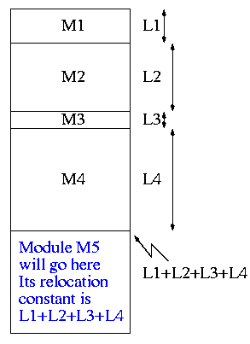
2. Relocating Relative Addresses (2/3)
How does the linker know that Module A is to be loaded starting at location 2300?
  It processes the modules one at a time. The first module is to be loaded at location zero. We say that the relocation constant is zero.
  Hence the next module is to be loaded starting at L1, i.e., the relocation constant is L1.
  In general the linker keeps the sum of the lengths of all the modules it has already processed; this sum is the relocation constant for the next module.

Slide 6
3. Resolving External References (1/3)
If a C program contains a function call
f(x)
to a function f() that is compiled separately, the resulting object module must contain some kind of jump to the beginning of f.
But this is impossible! Why?

Slide 7
3. Resolving External References (2/3)
Reason:
  When the C program is compiled, the compiler and assembler do not know the location of f() so there is no way they can supply the starting address.
Solution:
  Instead a dummy address is supplied and a notation made that this address needs to be filled in with the location of f(). This is called a use of f.

Slide 8
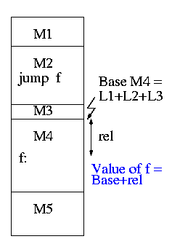
3. Resolving External References (3/3)
The object module M4 containing the definition of f() contains a notation that f is being defined and gives the relative address of the definition, which the linker converts to an absolute address
The linker then changes all uses of f() to the correct absolute address.

Slide 9
4. An Example from the Lab (1/6)
To see how a linker works lets consider the following example, which is the first dataset from lab #1. The description in lab1 is more detailed.
The target machine is word addressable and each word consists of 4 decimal digits. The first (leftmost) digit is the opcode and the remaining three digits form an address.
  1004

Slide 10
4. An Example from the Lab (2/6)
Each object module contains three parts
  a definition list
  a use list
  and the program text itself.
Each definition is a pair (sym, loc).
Each use is also a pair (sym, loc), but sym is used in other loc's.
The program text consists of a count N followed by N pairs (type, word), where word is a 4-digit instruction described above and type is a single character indicating if the address in the word is Immediate, Absolute, Relative, or External.

Slide 11
4. An Example from the Lab (3/6)
The (dummy) address initially in loc is a pointer to the next use of S. The linked list of uses ends with a pointer of 777.
a definition list
1 xy 2
1 z 4
5 R 1004 I 5678 E 2777 R 8002 E 7002
a use list
Type of oprand
program text
opcode
oprand

Slide 12
4. An Example from the Lab (4/6)
Input set #1
1 xy 2
1 z 4
5 R 1004 I 5678 E 2777 R 8002 E 7002
0
1 z 3
6 R 8001 E 1777 E 1001 E 3002 R 1002 A 1010
0
1 z 1
2 R 5001 E 4777
1 z 2
1 xy 2
3 A 8000 E 1777 E 2001

Slide 13
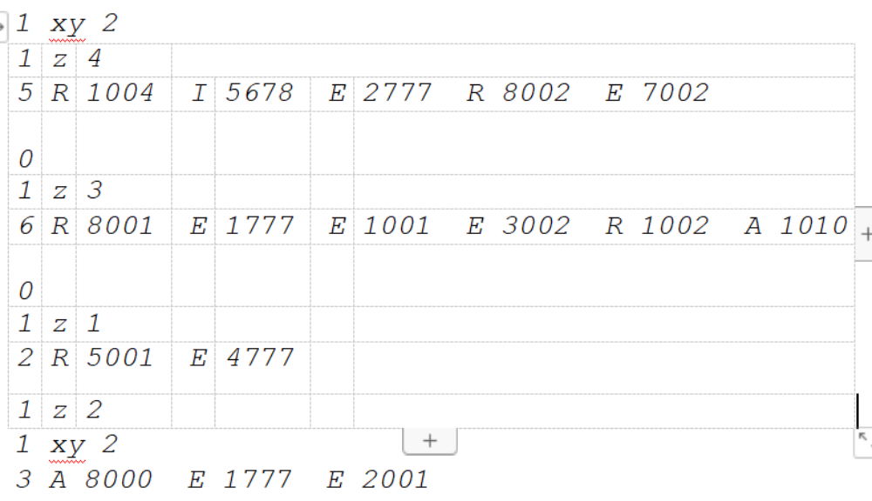
4. An Example from the Lab (5/6)
The first pass
  relocates R forming the absolute address A and stores the pair (S, A) in the symbol table.
  finds the base address of each module and produces the symbol table giving the values for xy and z (2 and 15 respectively).
xy=0+2
Symbol Table
xy=2
z=15
z=5+6+2+2=15

Slide 14
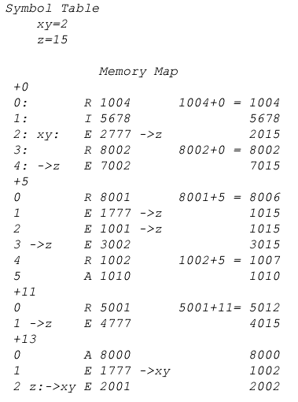
4. An Example from the Lab (6/6)
The second pass
  use the symbol table and base addresses produced in pass one to produce memory map

